Slide 1
CAE Final Project
Structural analysis of rear part of self-made electric car
and its development
21800773 Min-woong Han
21800805 Seung-eun Hwang
21900258 Hyeon-ho Mun
2023.12.18

Slide 2
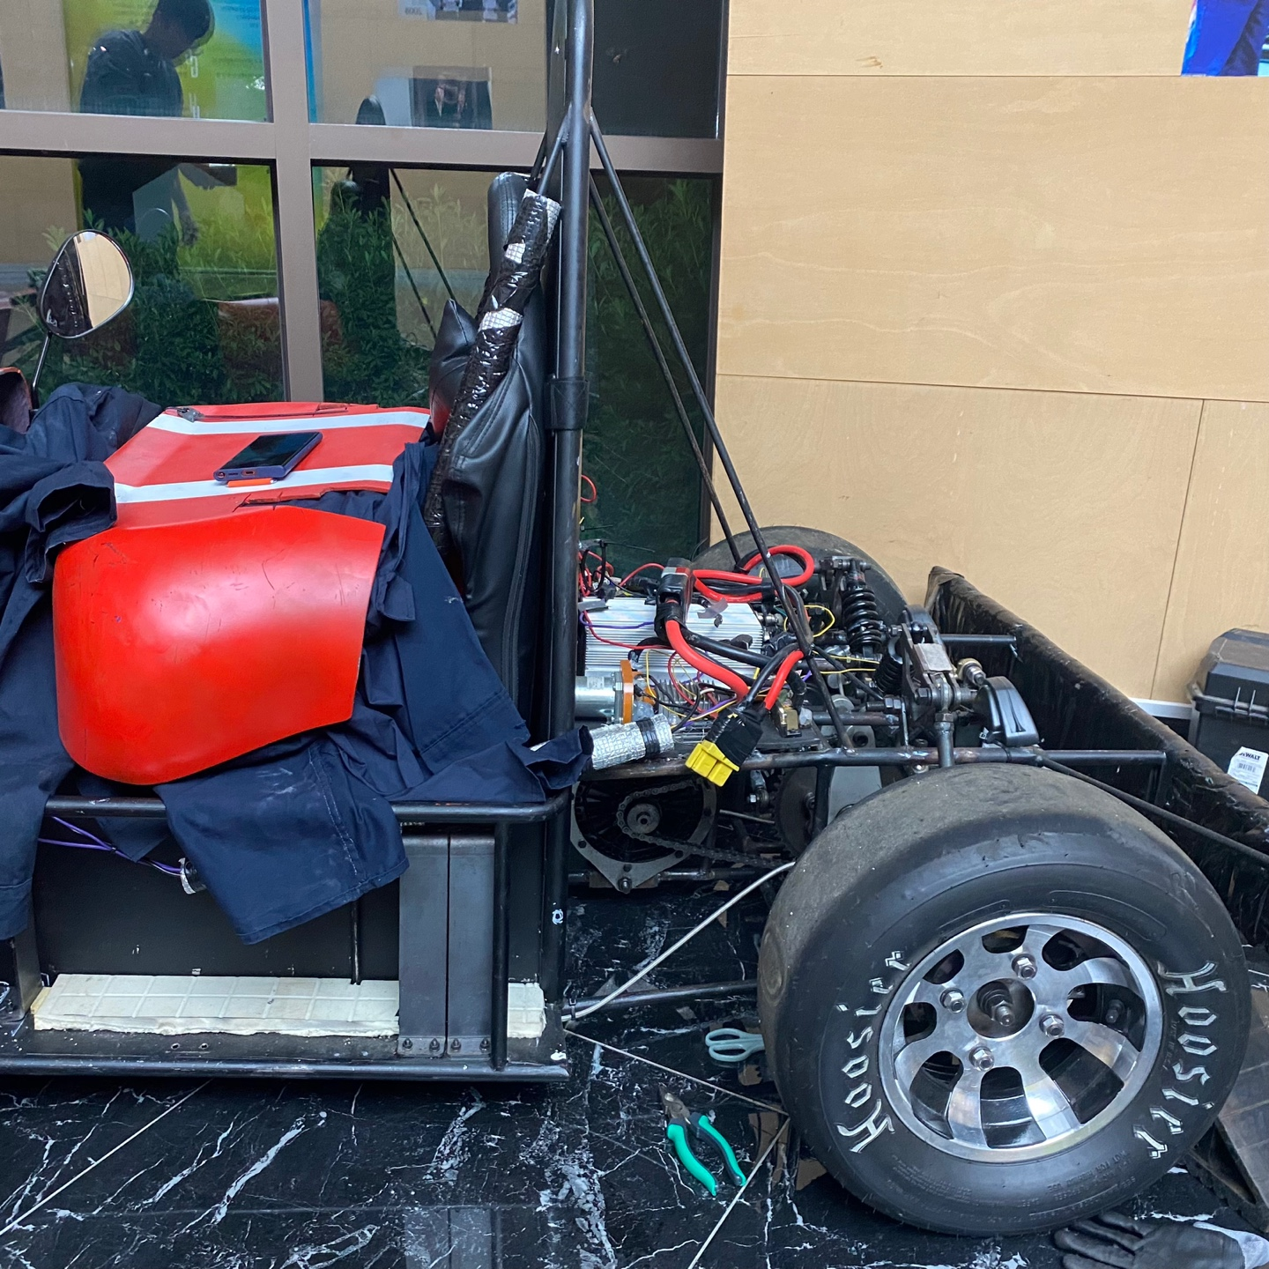
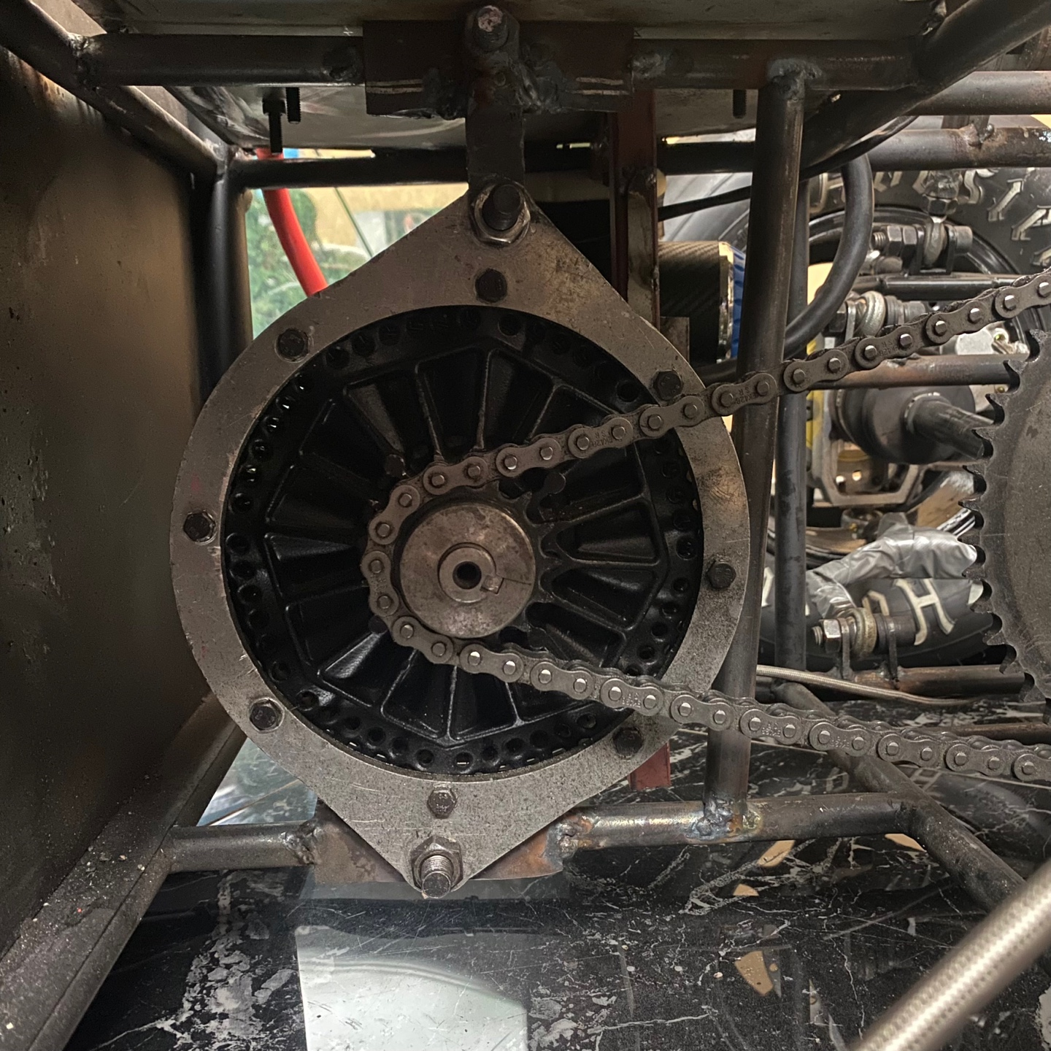
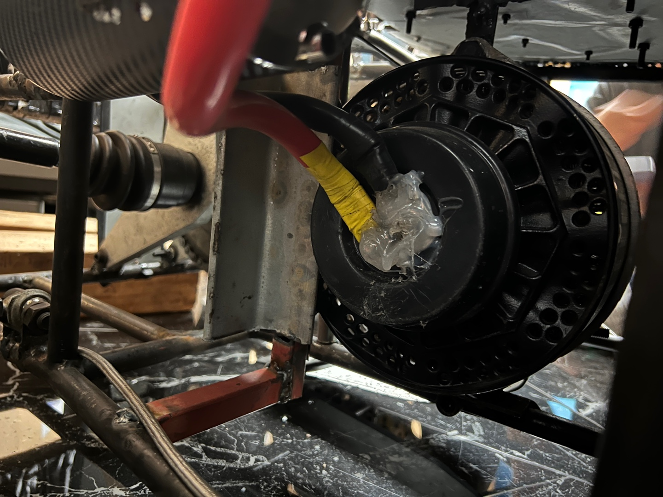
▣ Introduction
In the self-made electric car introduced here, the rear wheels move according to the driving of the motor. As the motor drives, the chain sprocket rotates, transmitting power to the large sprocket and driving the rear wheel. We aim to observe problems that occur depending on the maximum operation of the motor and analyze the exact cause using ANSYS software. And, the final goal is to make development for the original model later and analyze to what extent the problem areas can be improved. The figure below shows the case portion of the electric vehicle being analyzed and the motor that runs inside.
Figure #. Self-made electric car and its motor & chain components

Slide 3
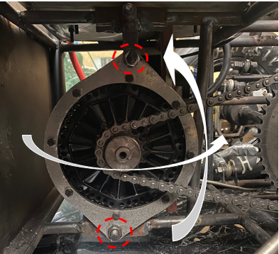
▣ Problem analysis
Problem statement
Under the maximum operating conditions of the motor, the force exerted by the chain on the sprocket cannot be ignored. When the motor is driven at maximum spec, chain tension occurs, which actually causes the following two main problems.
Chain loosening problem due to horizontal rotation of motor
Observation of material yield behavior due to strong stress acting on a specific frames
Since motor part of original model has only two point contacts with the frame, tension caused by motor driving with maximum spec causes horizontal rotation of the motor part. And it is connected with chain loosening problem. And some frame parts are exposed to the high stress, they are observed with yield behavior.
: point contact condition of motor case
: Frame in yield condition
Figure #. Contact condition of motor & Frame with yield

Slide 4
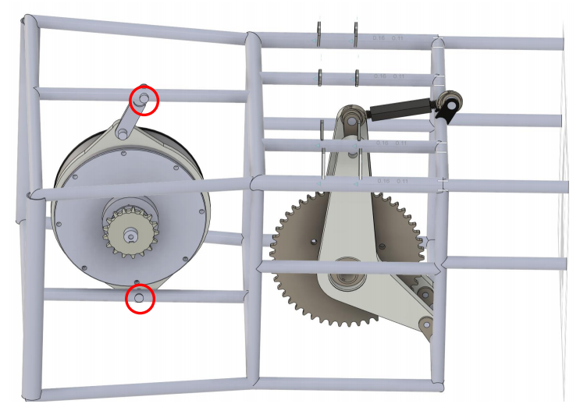
▣ 3D model generation
3D model
To proceed with the structural analysis in ANSYS software, a three-dimensional model of the rear part of the vehicle was created with SOLIDWORKS software. The rear frame and the motor case are modeled as right figure. And many components were eliminated to reduce the complexity of the model. And those were considered with force or boundary condition with eliminating.
Table #. Eliminated components
Eliminated components | Considered factor
Chain | Chain tension
Motor | Weight
Upper & Lower arm | Remote displacement
Suspension | Suspension force
Figure #. Rear part of the car (left), Generated 3D model (right)

Slide 5
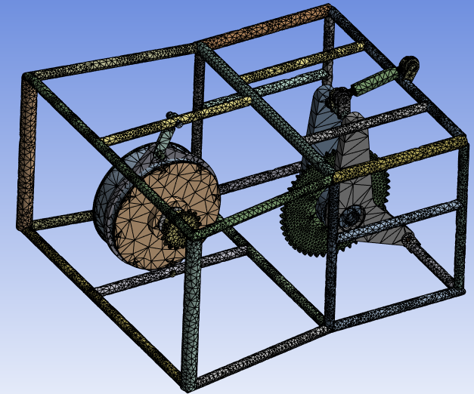
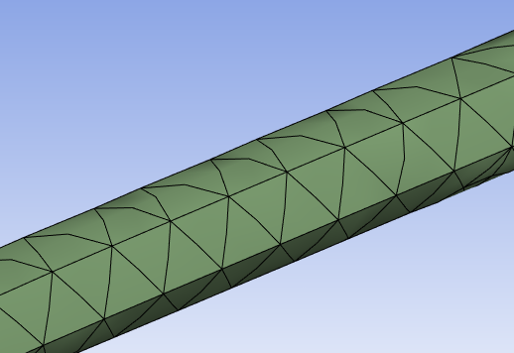
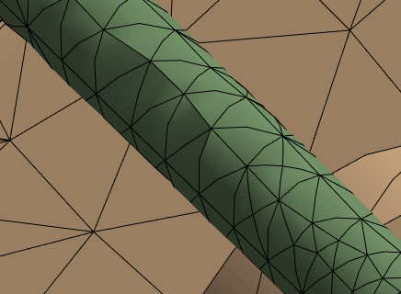
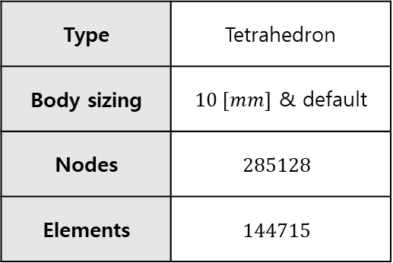
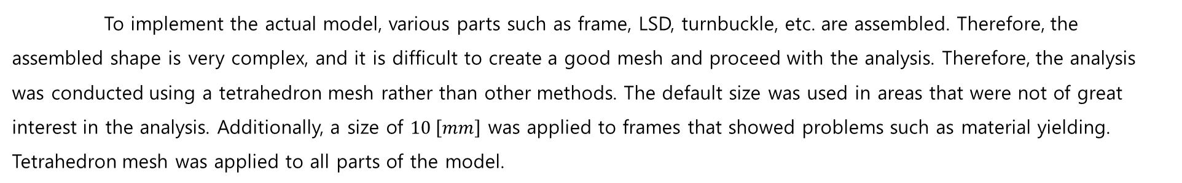
▣ Mesh generation
Tetrahedron mesh
To implement the actual model, various parts such as frame, LSD, turnbuckle, etc. are assembled. Therefore, the assembled shape is very complex, and it is difficult to create a good mesh and proceed with the analysis. Therefore, the analysis was conducted using a tetrahedron mesh rather than other methods. The default size was used in areas that were not of great interest in the analysis. Additionally, a size of $10 \left[mm\right]$ was applied to frames that showed problems such as material yielding. Tetrahedron mesh was applied to all parts of the model.
Table #. Mesh information
Type | Tetrahedron
Body sizing | $10 [mm]$ & default
Nodes | $$285128$$
Elements | $$144715$$
Figure #. Generated mesh, default sizing (2nd), $10 [mm]$ sizing (3rd)

Slide 6
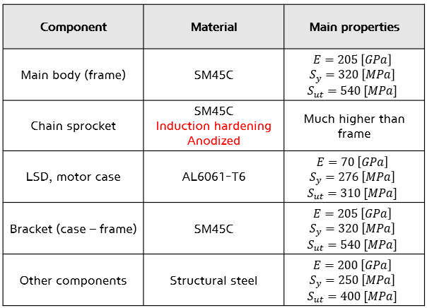
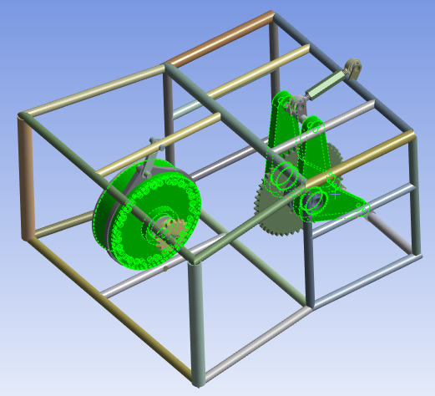
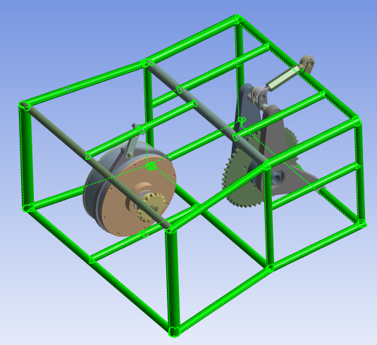
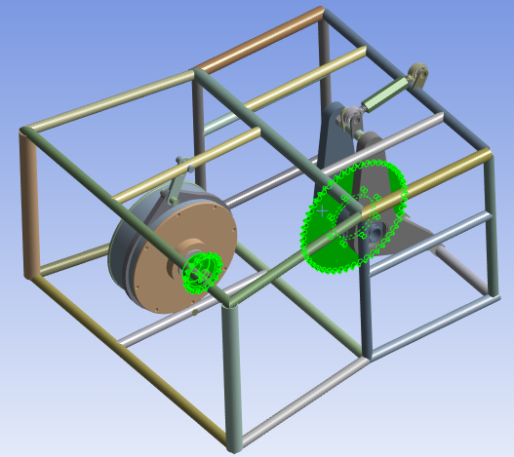
▣ Material
Used material
SM45C material was used for the frame. Additionally, because the chain sprocket must withstand the strong tension generated while the motor is running, SM45C with induction heat treatment and iron oxide coating was used. And, the LSD and motor case were made of aluminum 6061-T6 material. In addition, there are several parts including coupling bolts, etc., but since they are not actually important elements in the analysis, we set them to structural steel and proceeded with the analysis.
Table #. Material information
Figure #. AL 6061-T6 / SM45C / Strengthened SM45C

Slide 7
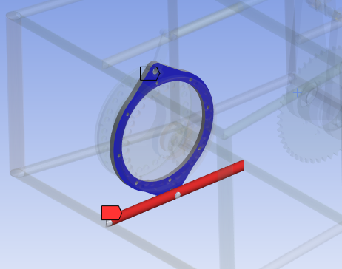
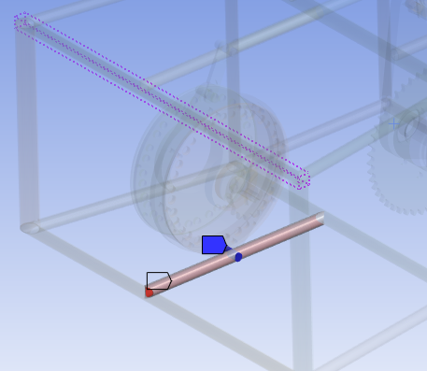
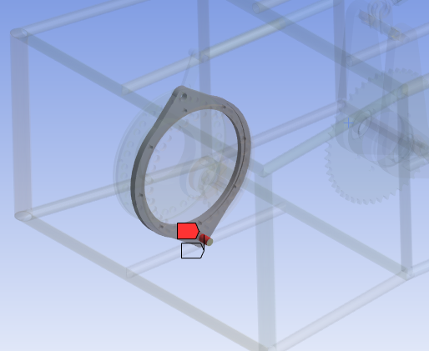
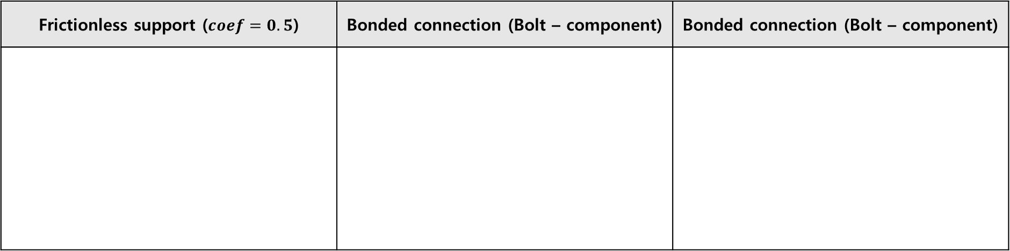
▣ Connection condition
Bolt fastening part
In analysis, appropriately setting the contact conditions between parts is an essential element in conducting accurate analysis. First, the conditions for the bolt fasteners were set as follows. The joint between the bolt and the part was set to bonded, and a frictionless connection condition of 0.5 friction coefficient was given to the parts that are fastened and in contact, considering friction. In addition, the bonded condition was given to all parts that are actually welded, such as frames.
Frictionless support ($coef=0.5$) | Bonded connection (Bolt – component) | Bonded connection (Bolt – component)
Figure #. Connection condition of bolt fastening part

Slide 8
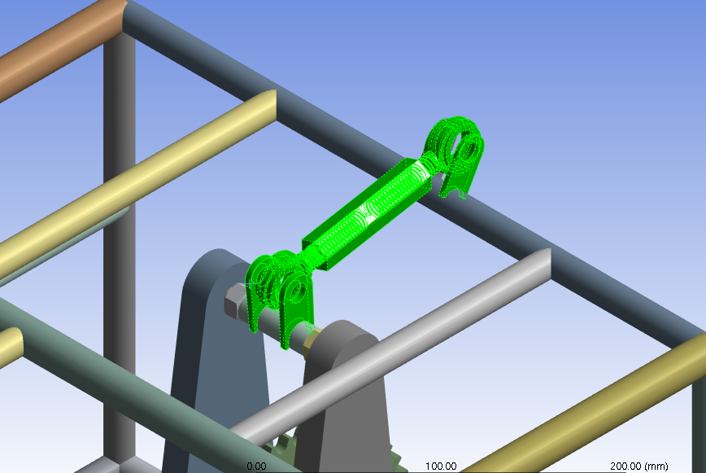
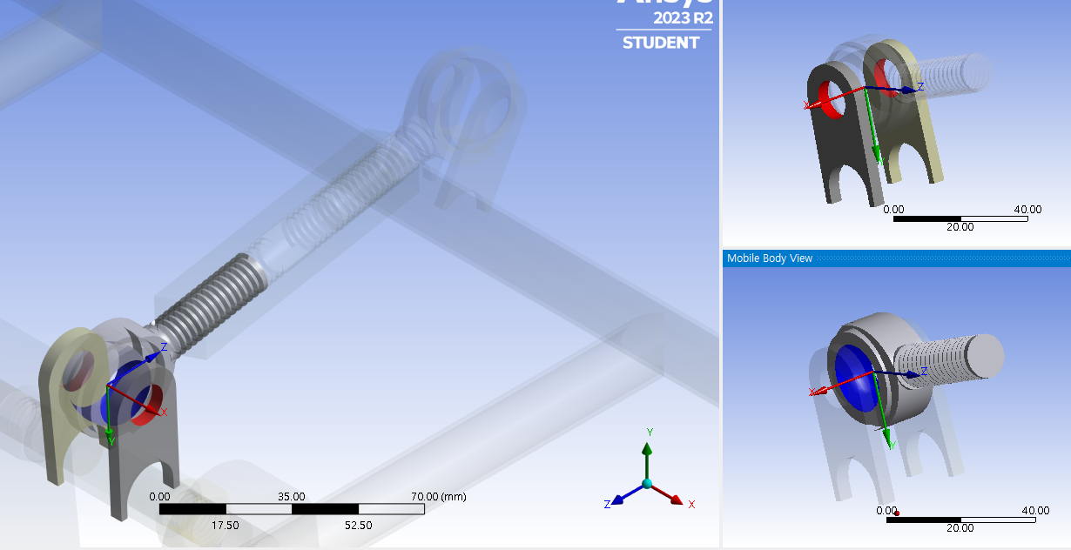
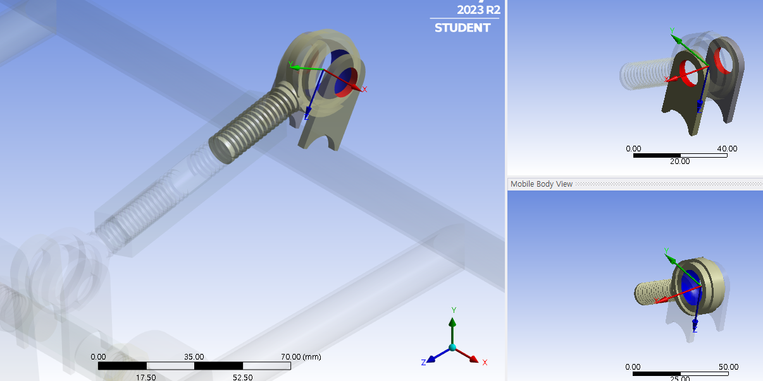
▣ Connection condition
Revolute joint
A revolute joint condition was given to the joint of the rear turnbuckle and rod end bearing. The reason for giving this condition is that it has the degree of freedom to rotate around the x-axis. The process for granting the connection is as follows. Both sides of the rod end bearing were set as scope faces, and the bearing part was set as mobile faces. A two revolute joint conditions were granted for a total of two connected parts.
Figure #. Revolute joint connection setting

Slide 9
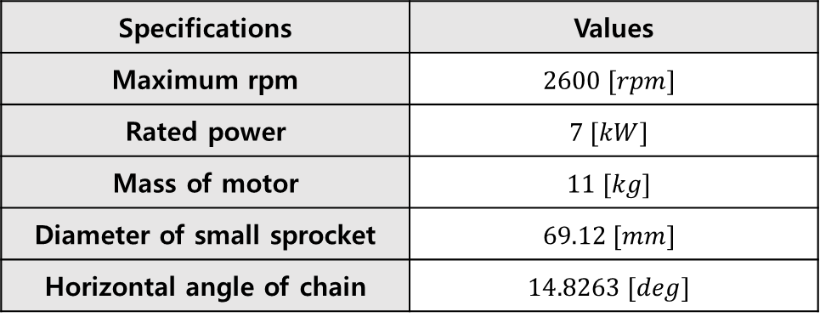
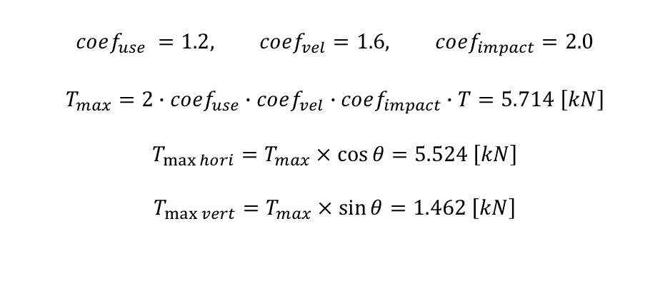
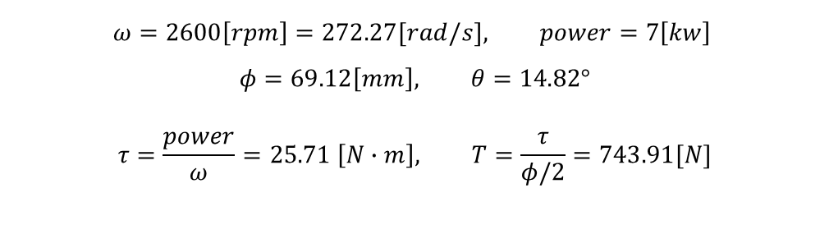
▣ Force analysis
Chain tension
After that, the most important thing is to consider the tension of the chain. The tension generated according to the maximum driving specifications of the motor was considered. Also, considering conditions such as impact coefficient, usage coefficient, etc., a force of about 3.5 times was considered. In addition, since the chain is designed with a safety factor of 10 in mind, the maximum force that occurs during sudden stops or acceleration was multiplied by about 7 times.
$$ω=2600\left[rpm\right]=272.27[rad/s], power=7\left[kw\right]$$
$$φ=69.12\left[mm\right], θ=14.82°$$
$$τ=\frac{power}{ω}=25.71 \left[N∙m\right], T=\frac{τ}{φ/2}=743.91[N]$$
Table #. Detailed specifications
Specifications | Values
Maximum rpm | $$2600 [rpm]$$
Rated power | $$7 [kW]$$
Mass of motor | $$11 [kg]$$
Diameter of small sprocket | $$69.12 [mm]$$
Horizontal angle of chain | $$14.8263 [deg]$$
$$coef_{use} =1.2, coef_{vel}=1.6, coef_{impact}=2.0$$
$$T_{max}=2∙coef_{use}∙coef_{vel}∙coef_{impact}∙T=5.714 \left[kN\right]$$
$$T_{\max{hori}}=T_{max}×\cos{θ}=5.524 \left[kN\right]$$
$$T_{\max{vert}}=T_{max}×\sin{θ}=1.462 \left[kN\right]$$

Slide 10
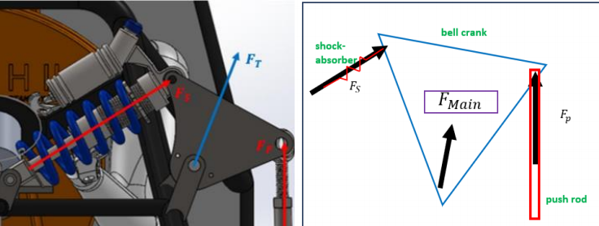


▣ Force analysis
Bell crank part
In the referenced paper, the force of the pushrod transmitted to the bell crank attached to the frame above the rear of the car is first calculated. Then, the suspension force($F_{s}$) and bell crank support force($F_{main}$) are obtained through static analysis. All relevant values ​​were taken from the referenced papers and used.
$$F_{s}=732 [N]$$
$$F_{tx}=682.1 \left[N\right]$$
$$F_{ty}=1214.2 [N]$$
$$F_{sx}=577.1554 \left[N\right]$$
$$F_{sy}=450.2396 [N]$$
Figure #. Forces related to bell crank part

Slide 11
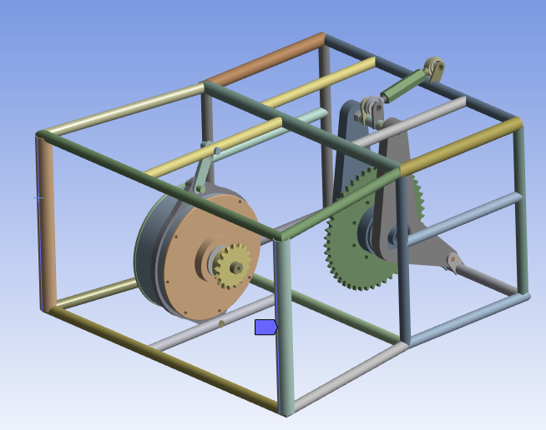
▣ Boundary condition
Fixed support
To obtain an accurate solution, it is also essential to provide appropriate fixed support conditions. In order to obtain an accurate solution, it is correct to model and analyze the entire vehicle, but since this is not possible, appropriate fixed support must be provided. As can be seen in the square box in the figure of the actual vehicle below, the vertical frames are line welded. Therefore, when conducting ANSYS analysis, an edge fixed support condition was given to vertical frames.
: Frame in edge welded condition
Figure #. Fixed boundary condition (edge part)

Slide 12
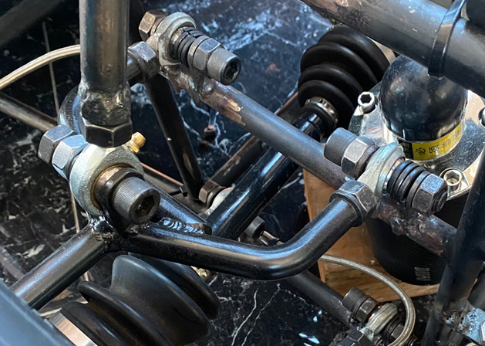
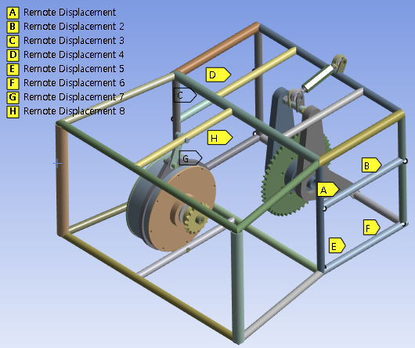
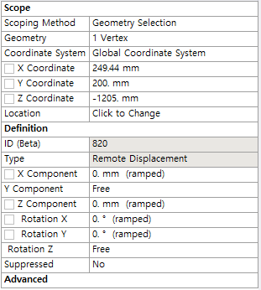
▣ Boundary condition
Remote displacement
Another important element is the arm connected part of the frame. Two lower arms and two upper arms are connected, and each is connected with two brackets welded to the frame as can be seen in the figure below. Therefore, a remote displacement boundary condition must be applied while removing the arm part. An offset was given considering the size of the welded bracket, and free conditions were given for the translational y element and rotation z element. A total of 8 conditions were granted.
Because vertices could be selected at the junction between frames, condition assignment was relatively simple.
Figure #. Remote displacement boundary condition

Slide 13
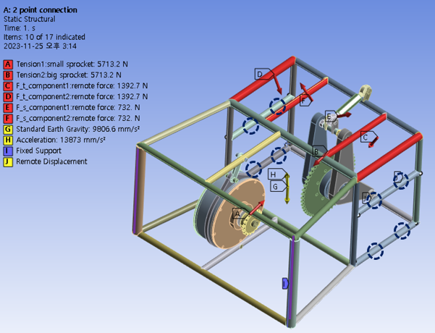
▣ Static analysis condition
Whole condition
Considered force
Tension on the chain sprockets
Influence of gravity & acceleration
Suspension & main force of upper frame
Boundary condition
Line fixed support (point welding)
Remote displacement (8 point)
(connecting part : arm – frame)
Figure #. Static analysis condition

Slide 14
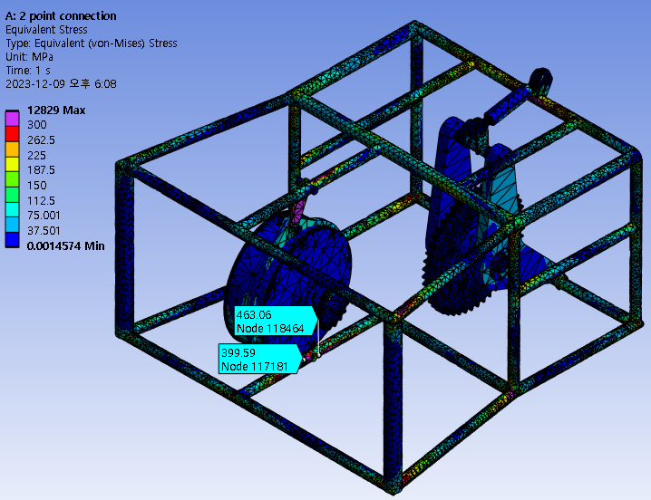
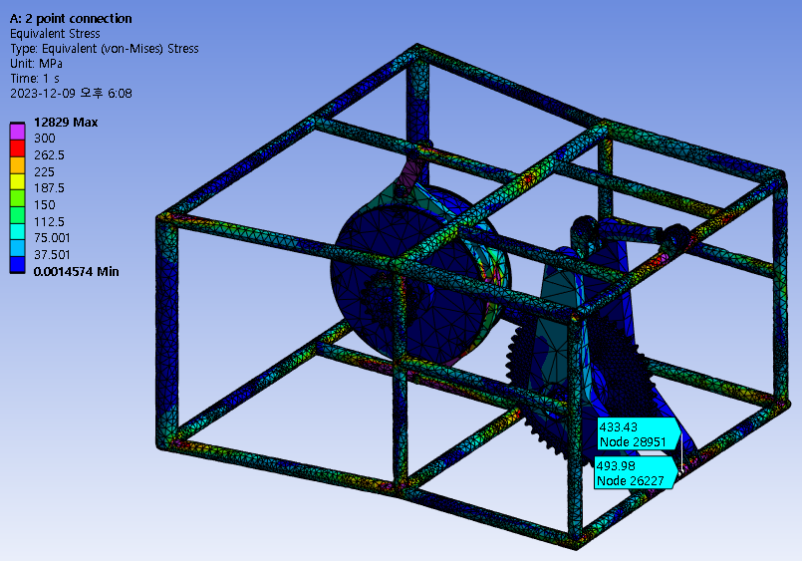
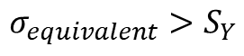
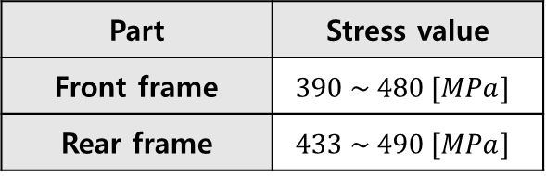
▣ Analysis result : problem model
Equivalent stress
As can be seen from the simulation results, when the maximum tension considered occurs, the stress on the frame, which was a problem during actual operation, appears as shown in the figure below. These stresses were observed to be higher than the yield stress of the material. The parts observed with the probe in the figure below are all frames that were problematic in actual operation.
Table #. Equivalent stress
Part | Stress value
Front frame | $$390 \sim 480 [MPa]$$
Rear frame | $$433 \sim 490 [MPa]$$
$$σ_{equivalent}>S_{Y}$$
Figure #. Equivalent stress values

Slide 15
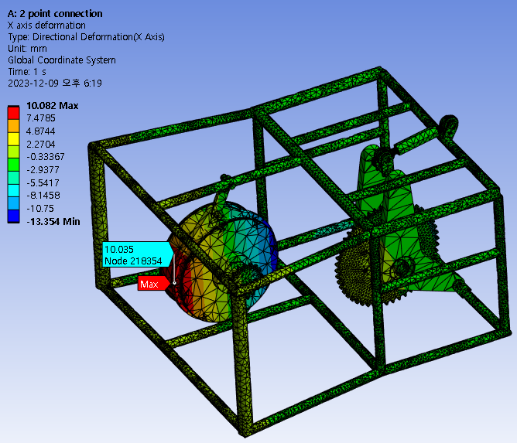
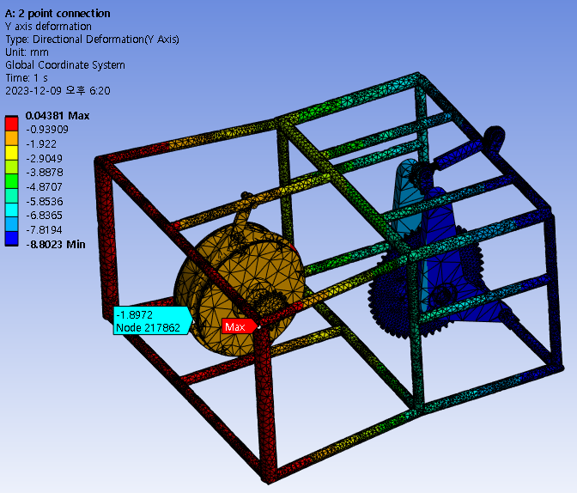
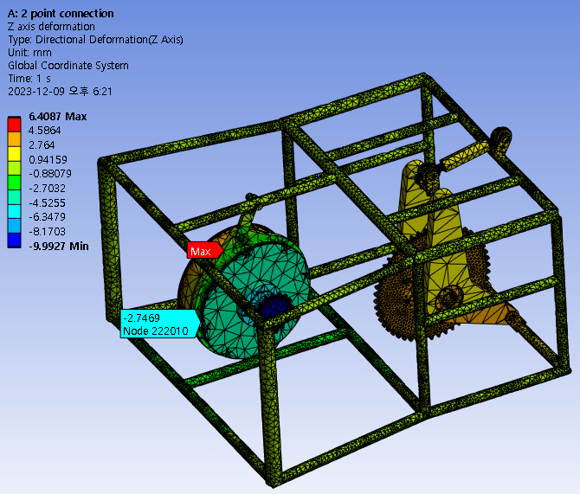
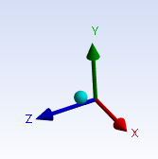
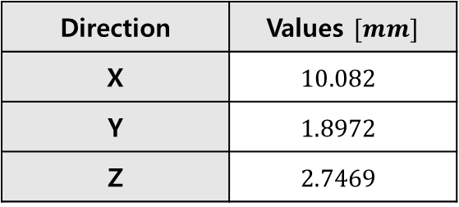
▣ Analysis result : problem model
Directional deformation
In addition to frame yielding, rotation due to tension in the motor case actually became a problem. This problem caused chain loosening problem. Therefore, it is necessary to observe the deformation values ​​in each direction. The figures below show deformation values ​​in the x, y, and z directions. Through the corresponding figures, it is possible to check the problem of the fixing conditions of the motor case, which is fixed through two point contact.
Table #. Directional deformation
Direction | Values $[mm]$
X | $$10.082$$
Y | $$1.8972$$
Z | $$2.7469$$
Figure #. Directional deformation values (x,y,z respectively)

Slide 16
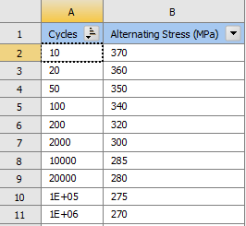
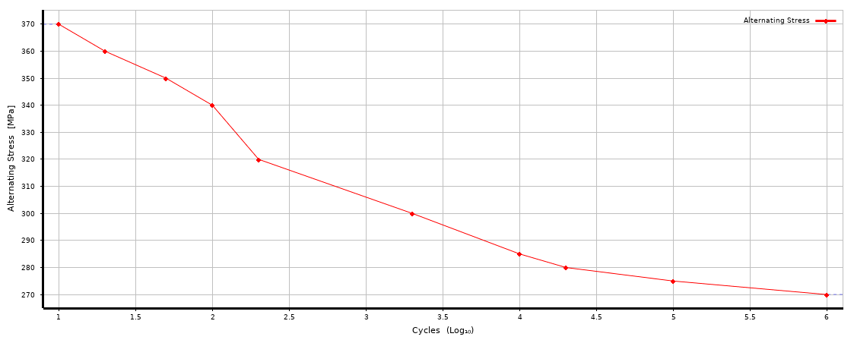
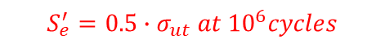
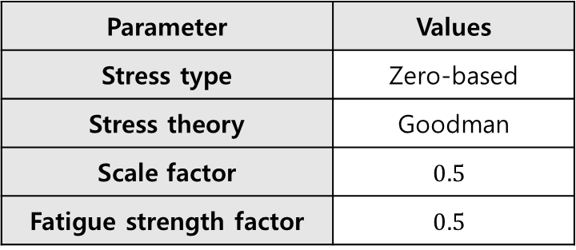
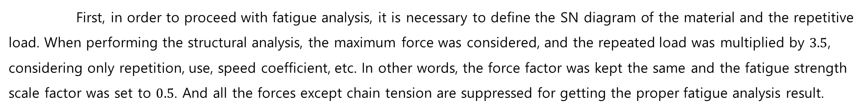

▣ Fatigue analysis
Analysis condition
First, in order to proceed with fatigue analysis, it is necessary to define the SN diagram of the material and the repetitive load. When performing the structural analysis, the maximum force was considered, and the repeated load was multiplied by $3.5$, considering only repetition, use, speed coefficient, etc. In other words, the force factor was kept the same and the fatigue strength scale factor was set to $0.5$. And all the forces except chain tension are suppressed for getting the proper fatigue analysis result.
Table #. Fatigue analysis condition
$$S_{e}^{′}=0.5∙σ_{ut} at {10}^{6}cycles$$
Parameter | Values
Stress type | Zero-based
Stress theory | Goodman
Scale factor | $$0.5$$
Fatigue strength factor | $$0.5$$
: $0.5∙σ_{ut}$
Figure #. SN curve definition
$$\frac{σ_{a}}{σ_{e}}+\frac{σ_{m}}{σ_{ut}}=\frac{1}{N}$$

Slide 17
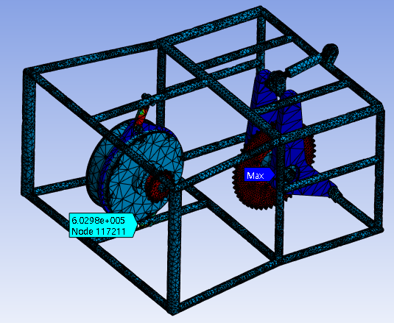
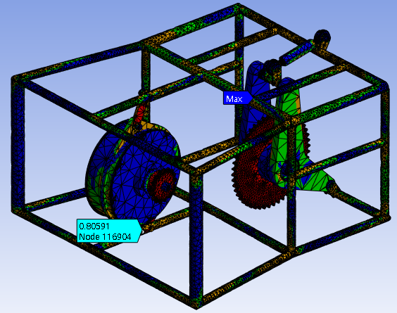
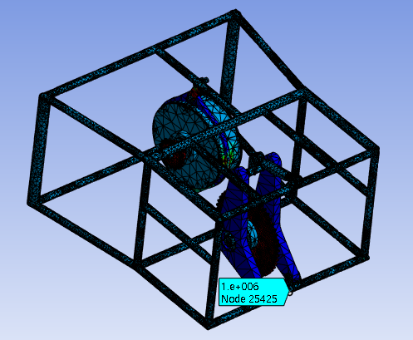
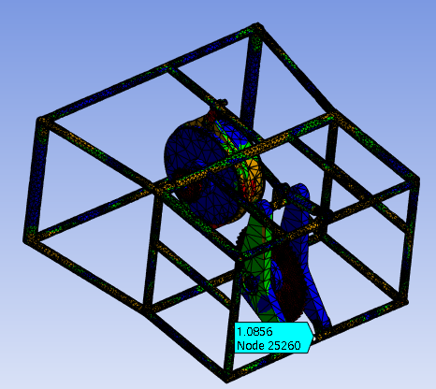
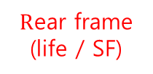
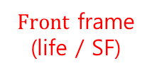

▣ Fatigue analysis
Fatigue analysis result
The figures below show safety factor values ​​according to the fatigue design life of $100,000$ cycles. As you can see from the results, you can see that the frame in question has a safety factor around $1.0$. In other words, it is essential to consider damage based on $100,000$ zero-based cycles.
Table #. Life & Safety factor values
Type |  | Values
Front frame | Life | $$6.0298e+05$$
 | SF | $$0.81$$
Rear frame | Life | $$1e+06$$
 | SF | $$1.09$$
$Front$ frame
(life / SF)
$R$ear frame
(life / SF)
Figure #. Life, safety factor

Slide 18

▣ Developing process
3D model
As can be seen from the previous structural analysis and fatigue analysis results, improvements are needed. First, in order to prevent horizontal rotation of the motor case, the existing two point contact conditions need to be improved. In this case, the existing 2 point contact conditions were improved to 3 point contact conditions. Additionally, a frame was added to the bottom right to consider the load distribution effect. Through this, it will be possible to prevent a specific frame from showing yield behavior due to distributed load.
Problem model
Developed model
Figure #. Problem model (left) and developed model(right)

Slide 19




▣ Analysis result : developed model
Equivalent stress
Equivalent stress
As can be seen from the simulation results, when the maximum tension considered occurs, the stress on the frame, which was a problem during actual operation, appears as shown in the figure below. These stresses were observed to be lower than the yield stress of the material. n other words, the load distribution effect was obtained through the addition of a frame and the motor case contact condition, and as a result, a maximum stress value lower than the material's yield stress was obtained.
Table #. Equivalent stress
Part | Stress value
Front frame | $$99 \sim 123.16[MPa]$$
Rear frame | $$78 \sim 100.26 [MPa]$$
$$σ_{equivalent}<S_{Y}$$
Figure #. Equivalent stress values

Slide 20




▣ Analysis result : developed model
Directional deformation
In addition to frame yielding, rotation due to tension in the motor case actually became a problem. This problem caused chain loosening problem. Therefore, it is necessary to observe the deformation values ​​in each direction in the developed model. The figures below show deformation values ​​in the x, y, and z directions of the developed model. Through the corresponding figures, it is possible to check the positive effect of adding one more point contact of the motor case.
Table #. Directional deformation
Direction | Values $[mm]$
X | $$0.903$$
Y | $$1.6874$$
Z | $$0.3715$$
Figure #. Directional deformation values (x,y,z respectively)

Slide 21







▣ Fatigue analysis
Fatigue analysis result
The improved model that added 3 points and a frame also utilized the same fatigue analysis conditions as the previous problem model. The following figures show the fatigue analysis results for the improved model. Since high stress concentrated values are unreliable, the values around the interested part are averaged to use.
Table #. Life & Safety factor values
Type |  | Values
Front frame | Life | $$1e+06$$
 | SF | $$3.3251$$
Rear frame | Life | $$1e+06$$
 | SF | $$6.75$$
$Front$ frame
(life / SF)
$R$ear frame
(life / SF)
Figure #. Life, safety factor

Slide 22



▣ Simulation result comparison
Deformation
The comparison of simulation results for deformation between the problem model and the improved model is as follows.
Table #. Comparison of deformation value
Problem model |  | Developed model
Direction | Values $[mm]$ | Direction | Values $[mm]$
X | $$10.082$$ | X | $$0.903$$
Y | $$1.8972$$ | Y | $$1.6874$$
Z | $$2.7469$$ | Z | $$0.3715$$
Total deformation | $$10.408$$ | Total deformation | $$1.9449$$
Figure #. Comparison of total deformation values

Slide 23

▣ Simulation result comparison
Equivalent stress
The comparison of simulation results for stress values between the problem model and the improved model is as follows.
Table #. Comparison of equivalent stress value
Problem model |  | Developed model
Part | Values $[MPa]$ | Part | Values $[Mpa]$
Front frame | $$390 \sim 480$$ | Front frame | $$99 \sim 123.16$$
Rear frame | $$433 \sim 490$$ | Rear frame | $$78 \sim 100.26$$
Problem model
Developed model

Slide 24

▣ Simulation result comparison
Fatigue safety factor
The comparison of fatigue analysis results between the problem model and the improved model is as follows.
Table #. Comparison safety factor values
Problem model |  | Developed model
Part | Values $[−]$ | Part | Values $[−]$
Front frame | $$0.81$$ | Front frame | $$3.3251$$
Rear frame | $$1.09$$ | Rear frame | $$6.75$$
Problem model
Developed model

Slide 25




▣ Discussion
Result analysis
Table #. Decreased deformation
Table #. Decreased equivalent stress
Table #. Increased fatigue safety factor
Changes of deformation
Parameter | Change $[mm]$
x deformation | $$−9.179$$
y deformation | $$−0.2098$$
z deformation | $$−2.3754$$
total deformation | $$−8.4631$$
Changes of equivalent stress
Part | Change $[MPa]$
Front frame | $$−323.92$$
Rear frame | $$−372.37$$
Changes of equivalent stress
Part | Change $[−]$
Front frame | $$2.52$$
Rear frame | $$5.66$$
The tables above show changes in simulation results when analysis was performed from the existing problematic model to the improved model through the development process. First, when one more vertical frame is added to create a 3-point contact fixation condition for the motor case, it can be seen that the total deformation is reduced by about $8 [mm]$, which solves the chain loosening problem in actual driving. I think it will be sufficient. Additionally, by adding two more frames in the below rear part, the expected load distribution effect was achieved, and as a result, a load reduction effect of over $300 [MPa]$ was seen for the two problematic frames. Accordingly, the effect of increasing the fatigue safety factor for ${10}^{5}$ cycles can also be confirmed.

Slide 26
▣ Conclusion
First, it is essential to identify elements that may be problematic in the actual operation of the vehicle, and to look at the deformation form of the material to find elements that may be problematic. In our case, the problem was the phenomena caused by chain tension that occurs when the electric vehicle's motor runs at its maximum.
Chain loosening problem due to horizontal rotation of motor case which is fixed with 2 point contact
Yield behavior of materials in specific frames
A 3D model was created to accurately identify the problems, and analysis was performed by setting connection and boundary conditions similar to reality in ANSYS software. After that, we confirmed that problems similar to actual problems occurred under the driving conditions, and we were also able to confirm the numbers. Accordingly, by designing an improved model and conducting structural analysis under the same conditions for the model, the expected improved results were also obtained.

Slide 27
▣ Reference
Jin-Ho Kook (2022). Simulation-based Light Weight Design of A Self-made Electric Vehicle Frame

Slide 28



▣ Appendix
Motor specifications
Figure #. Motor specifications

Slide 29


▣ Appendix
Calculation of parameters (MATLAB code)
Figure #. MATLAB code for calculation

Slide 30
▣ Appendix
Manual : mesh generation

